Slide 1
Beyond Supervised Facial Landmark Detection: Disentangled Representation and Face Synthesis
Presenter: Shengju Qian
@CUHK

Slide 2
Outline
Overview of Facial Landmark Detection
Existing Challenges
Relations with Representation Learning
Relations with Face Synthesis
Proposed Solution
S. Qian et al. Make a Face: Towards Arbitrary High-Fidelity Face Manipulation. In ICCV, 2019.
S. Qian et al. Aggregation via Separation: Boosting Facial Landmark Detector with Semi-Supervised Style Translation.
In ICCV, 2019.

Slide 3
Outline
Overview of Facial Landmark Detection
Existing Challenges
Relations with Representation Learning
Relations with Face Synthesis
Proposed Solution
S. Qian et al. Make a Face: Towards Arbitrary High-Fidelity Face Manipulation. In ICCV, 2019.
S. Qian et al. Aggregation via Separation: Boosting Facial Landmark Detector with Semi-Supervised Style Translation.
In ICCV, 2019.

Slide 4
Facial Landmark Detection
“Traditiona”l Face Alignment
Active Appearance Model
Pre-Deep Learning Era
Learning-based Method
Supervised Descent Method(SDM)
Cascade Regression(CFSS)
Ensemble of Regression Trees(ERT)
Now??
Deep Learning: end-to-end, global solution, good optimiozation
Optimizing over the coefficients rather than the target!

Slide 5
Facial Landmark Detection
Current researches on facial landmark detection mainly focus on two direction:
Learning a robust and discriminative model through network structure design or shape prior.
Design meaningful loss function or metrics.
W. Wu et al. Look at Boundary: A Boundary-Aware Face Alignment Algorithm. In CVPR, 2018.
ZH. Feng et al. Wing Loss for Robust Facial Landmark Localisation with Convolutional Neural Networks. In CVPR, 2018.

Slide 6
Outline
Overview of Facial Landmark Detection
Existing Challenges
Relations with Representation Learning
Relations with Face Synthesis
Proposed Solution
S. Qian et al. Make a Face: Towards Arbitrary High-Fidelity Face Manipulation. In ICCV, 2019.
S. Qian et al. Aggregation via Separation: Boosting Facial Landmark Detector with Semi-Supervised Style Translation.
In ICCV, 2019.

Slide 7
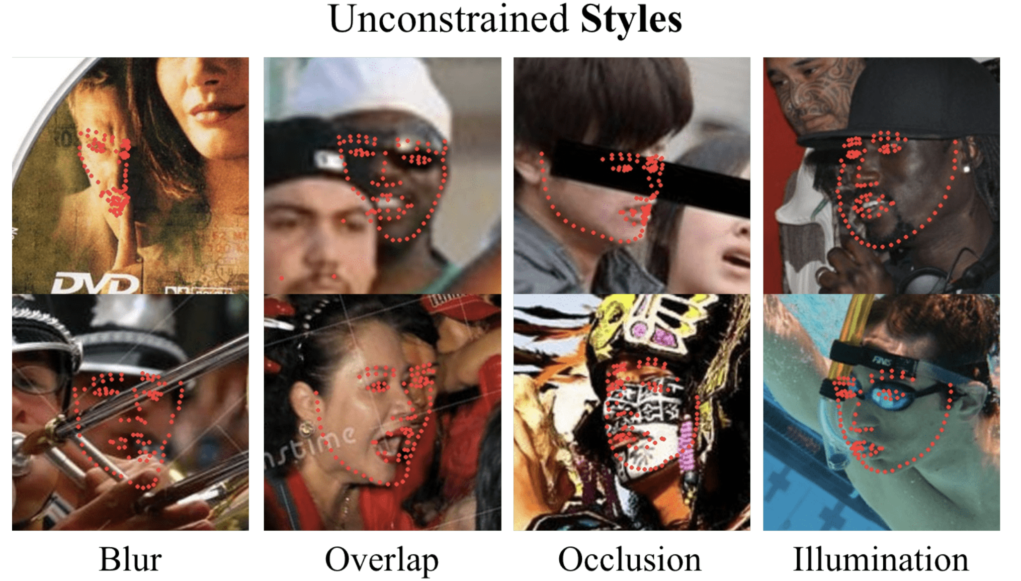
Challenges in Facial Landmark Detection
Real-time on Mobile devices
Localization Accuracy
“Style” Variations in Face images
Limited Training Samples
Expensive Annotation Cost
Can we use synthetic images to train our model?
How to synthesis face images with labeled landmarks?

Slide 8
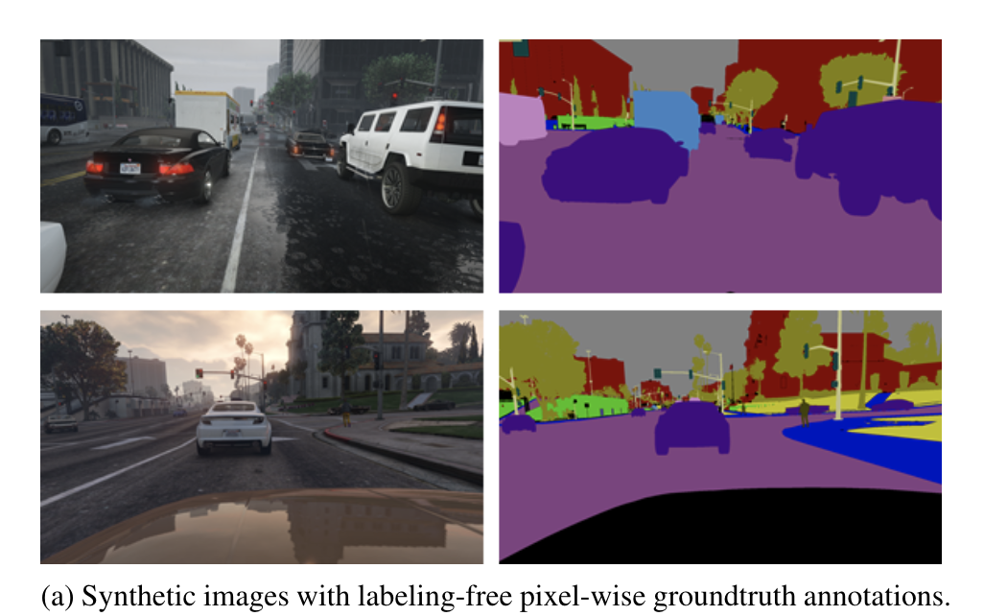
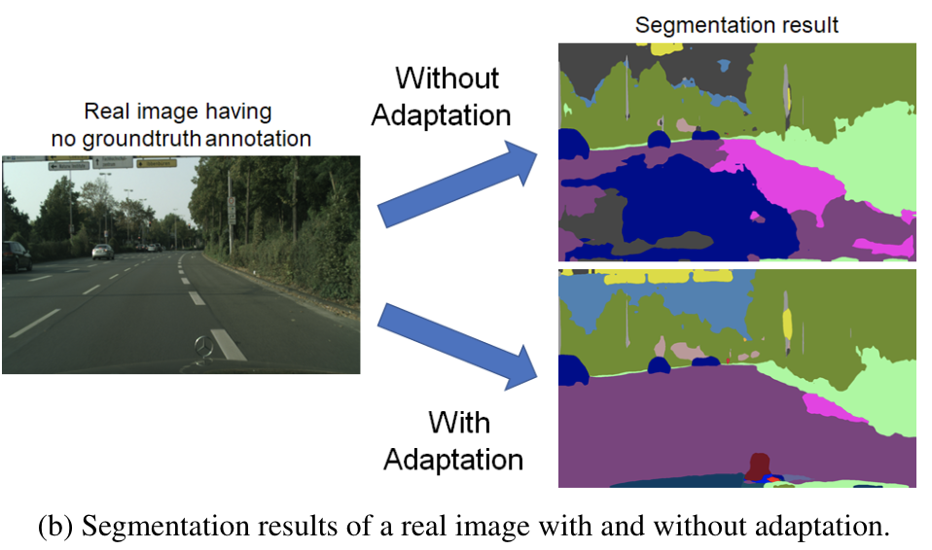
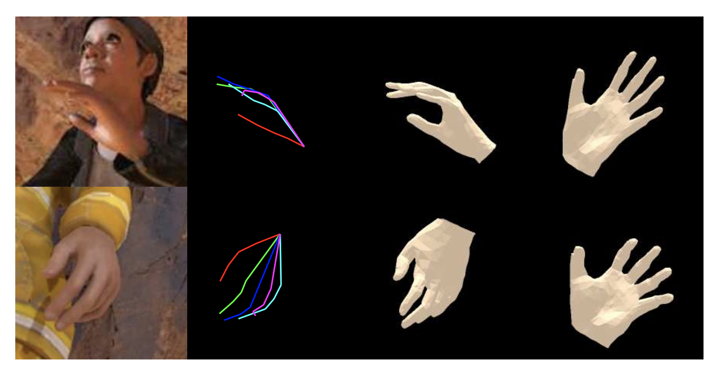
Can we use synthetic images to train a real-world model?
Unsupervised Domain Adaptation for semantic segmentation
Use GAME(GTA-5) images as source domain, generalize to real-world images
Neural Rendering to synthesis RGB-hands for pose estimation
An rendering engine is used for synthesizing realistic results

Slide 9
How to synthesis face images with labeled landmarks?
Preliminary Requirements:
Synthetic images mush preserve the input landmarks. (Structure Coherence)
Without other external information(e.g. 3DMM, rendering engine). (Self-/Unsupervised)
Disentangled Representation Learning :
If we can disentangle information expect landmarks,then re-combining this factor with any landmarks, Structure Coherence can be achieved.
Face Synthesis:
Realistic synthesized images can facilitate our method.

Slide 10
Outline
Overview of Facial Landmark Detection
Existing Challenges
Relations with Representation Learning
Relations with Face Synthesis
Proposed Solution
S. Qian et al. Make a Face: Towards Arbitrary High-Fidelity Face Manipulation. In ICCV, 2019.
S. Qian et al. Aggregation via Separation: Boosting Facial Landmark Detector with Semi-Supervised Style Translation.
In ICCV, 2019.

Slide 11
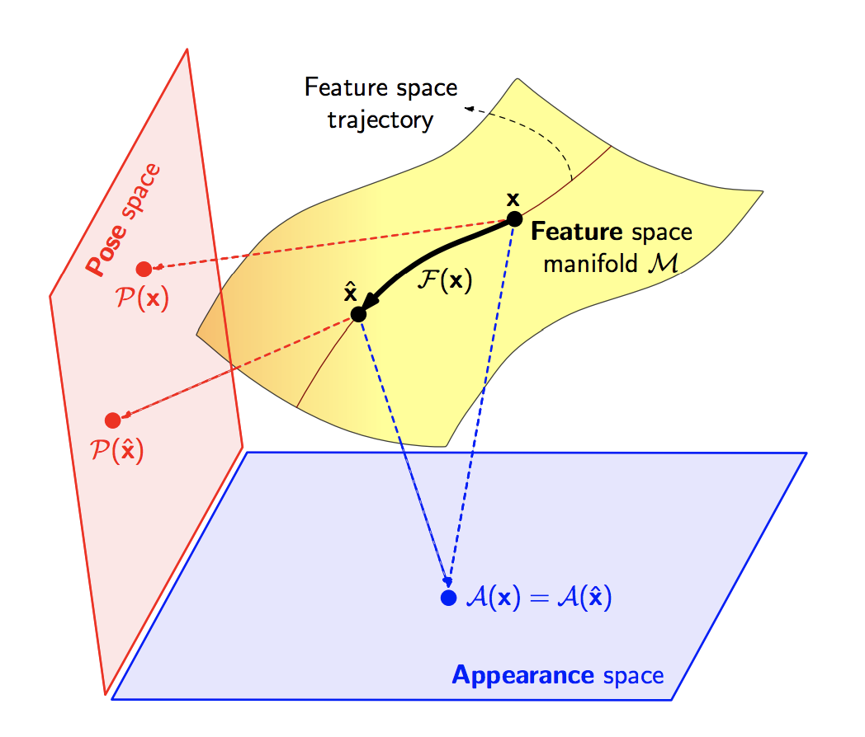
Relations with Representation Learning
Assume any face images can be factored into space of style that captures lighting, texture and image environment, and a style-invariant structure space. (Pose and Appearance)
Then re-rendering of two spaces can synthesize images that are not include in the training set.
The question becomes: How to disentangle an images to style and structure?

Slide 12
Outline
Overview of Facial Landmark Detection
Existing Challenges
Relations with Representation Learning
Relations with Face Synthesis
Proposed Solution
S. Qian et al. Make a Face: Towards Arbitrary High-Fidelity Face Manipulation. In ICCV, 2019.
S. Qian et al. Aggregation via Separation: Boosting Facial Landmark Detector with Semi-Supervised Style Translation.
In ICCV, 2019.

Slide 13
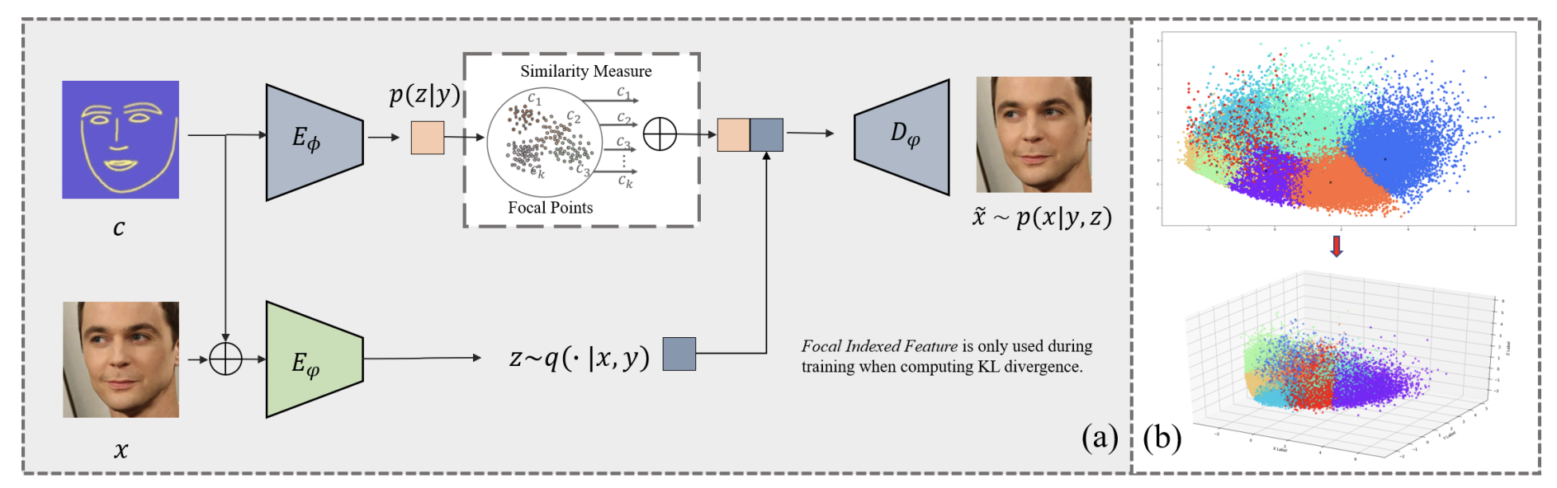
Relations with Face Synthesis
S. Qian et al. Make a Face: Towards Arbitrary High-Fidelity Face Manipulation. In ICCV, 2019.

Slide 14
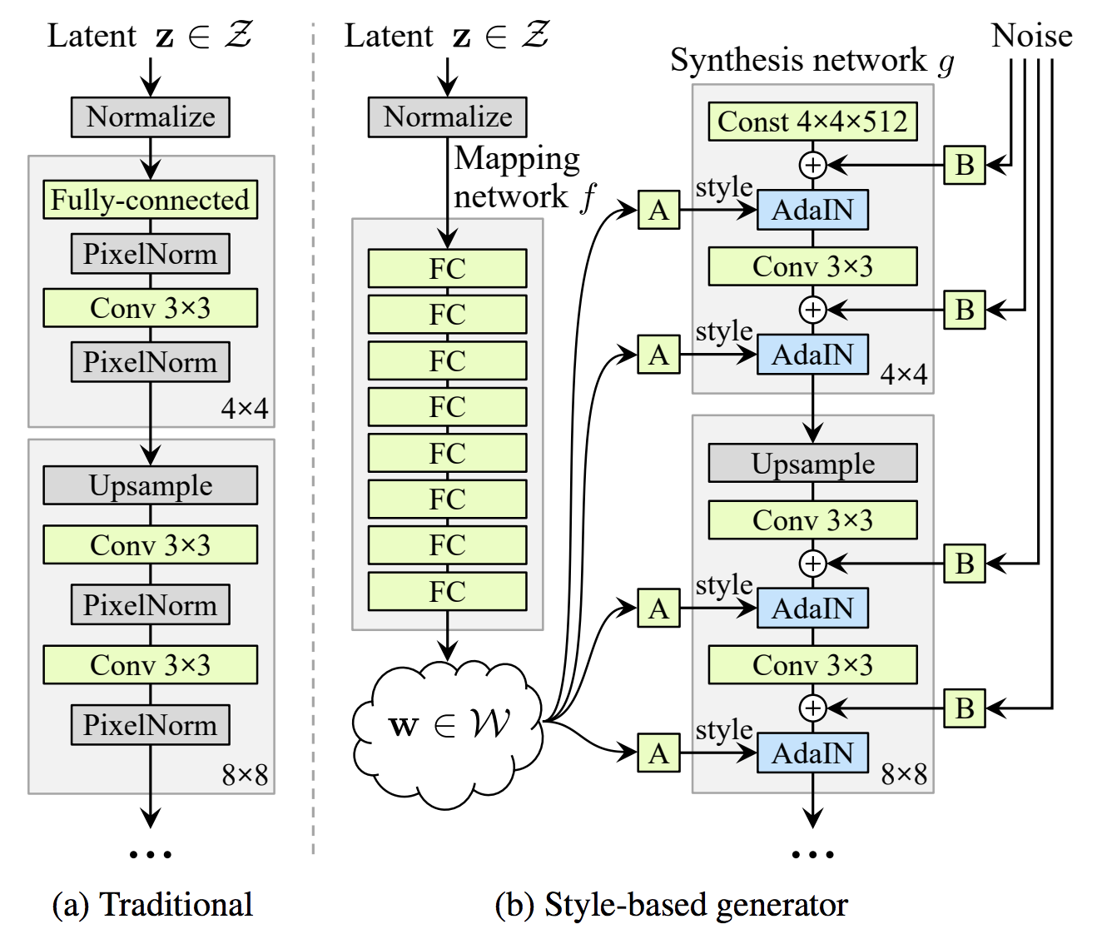
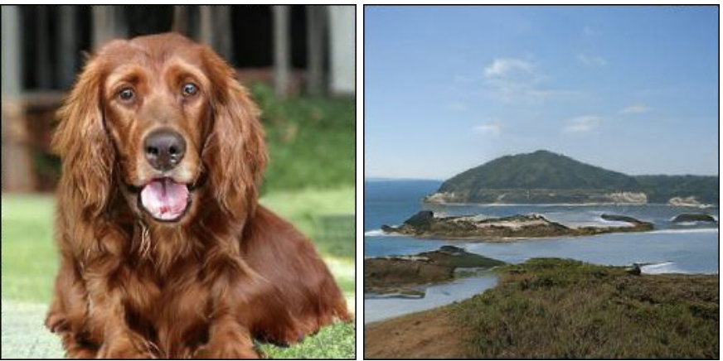
Relations with Face Synthesis
Recent Progress in image/face synthesize can further boost our approach. While here we delivers the possibility of augmentation in style space and doesn’t emphasize much on quality.
Try tricks proposed in BIGGAN
Use Style-Based generator

Slide 15
Outline
Overview of Facial Landmark Detection
Existing Challenges
Relations with Representation Learning
Relations with Face Synthesis
Proposed Solution
S. Qian et al. Make a Face: Towards Arbitrary High-Fidelity Face Manipulation. In ICCV, 2019.
S. Qian et al. Aggregation via Separation: Boosting Facial Landmark Detector with Semi-Supervised Style Translation.
In ICCV, 2019.

Slide 16
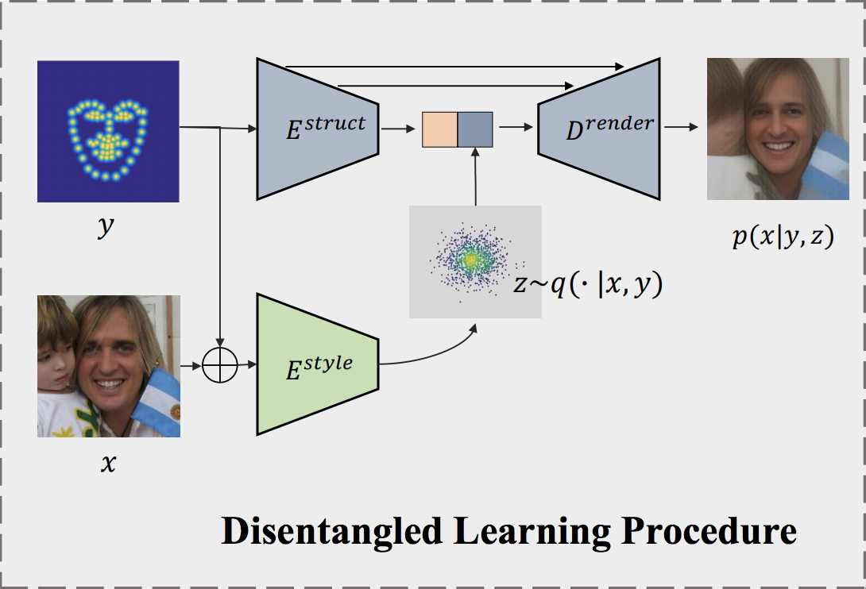
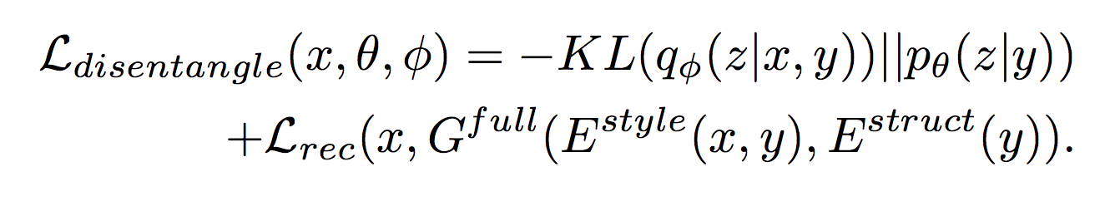
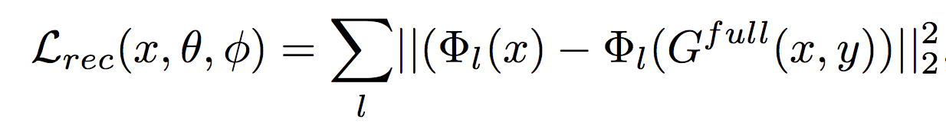
Proposed Solution
How to disentangle an images to style and structure?
A Conditional VAE structure is proposed: As landmarks available in this task, our goal therefore becomes inferring disentangled style code z.
KL-Divergence Loss:
Reconstruction(Perceptual) Loss

Slide 17
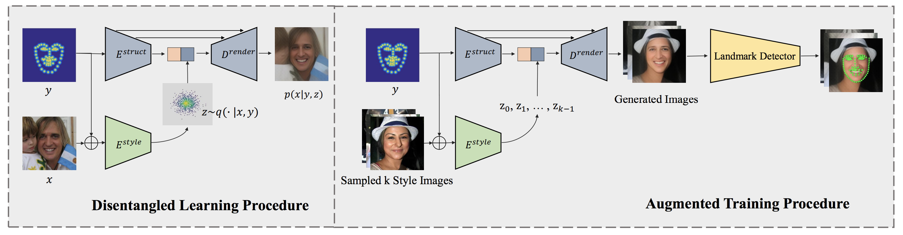
Proposed Solution
KL Divergence Loss: It measures the similarity between the variational posterior and prior distribution and is taken as regularization that discourages style Encoder to encode structure information.
Intuition: The KL-divergence loss limits the distribution range and capacity of the style feature. By fusing inferred style code z with encoded structure representation, sufficient structure information can be obtained from prior through skip connection

Slide 18
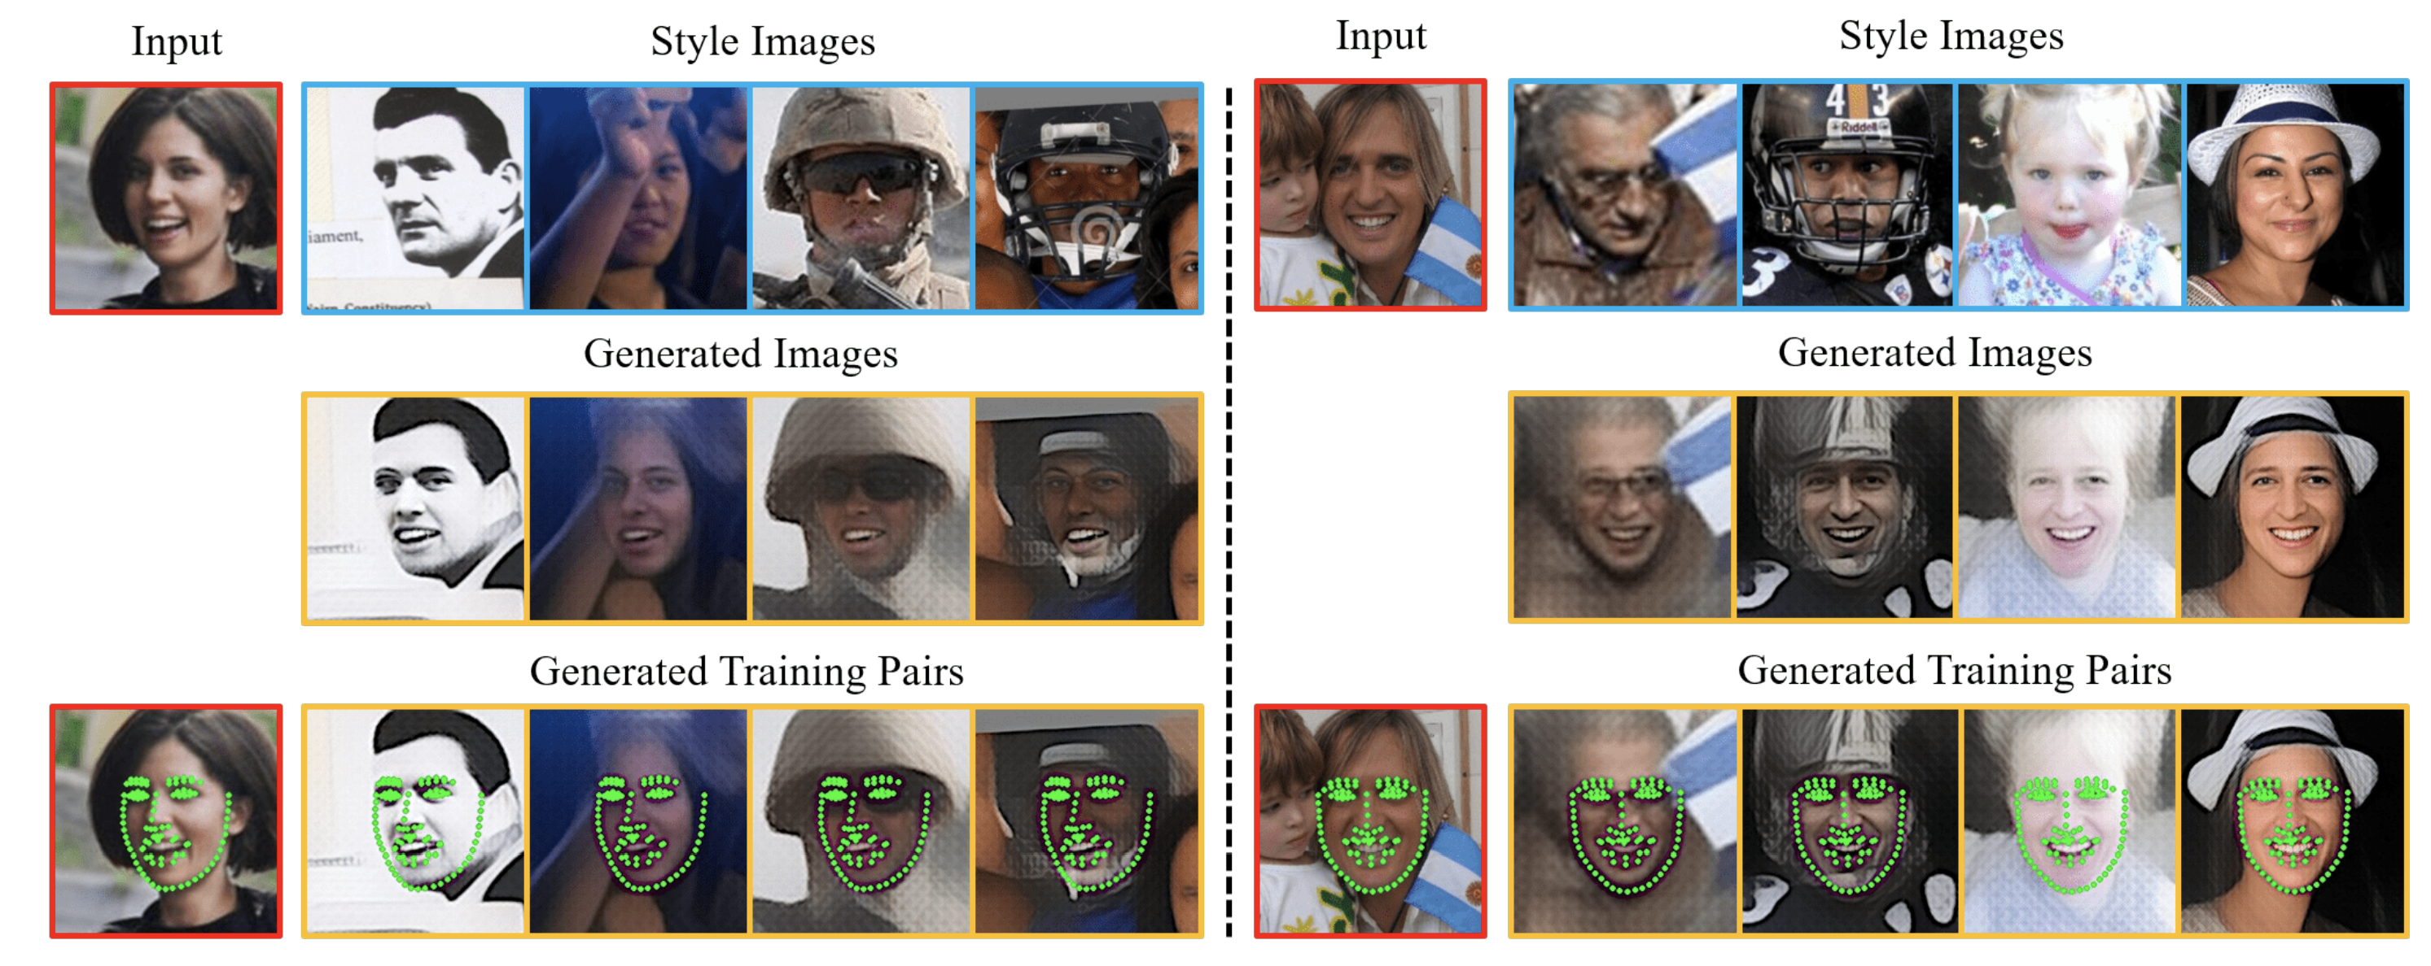
Experiment Results

Slide 19
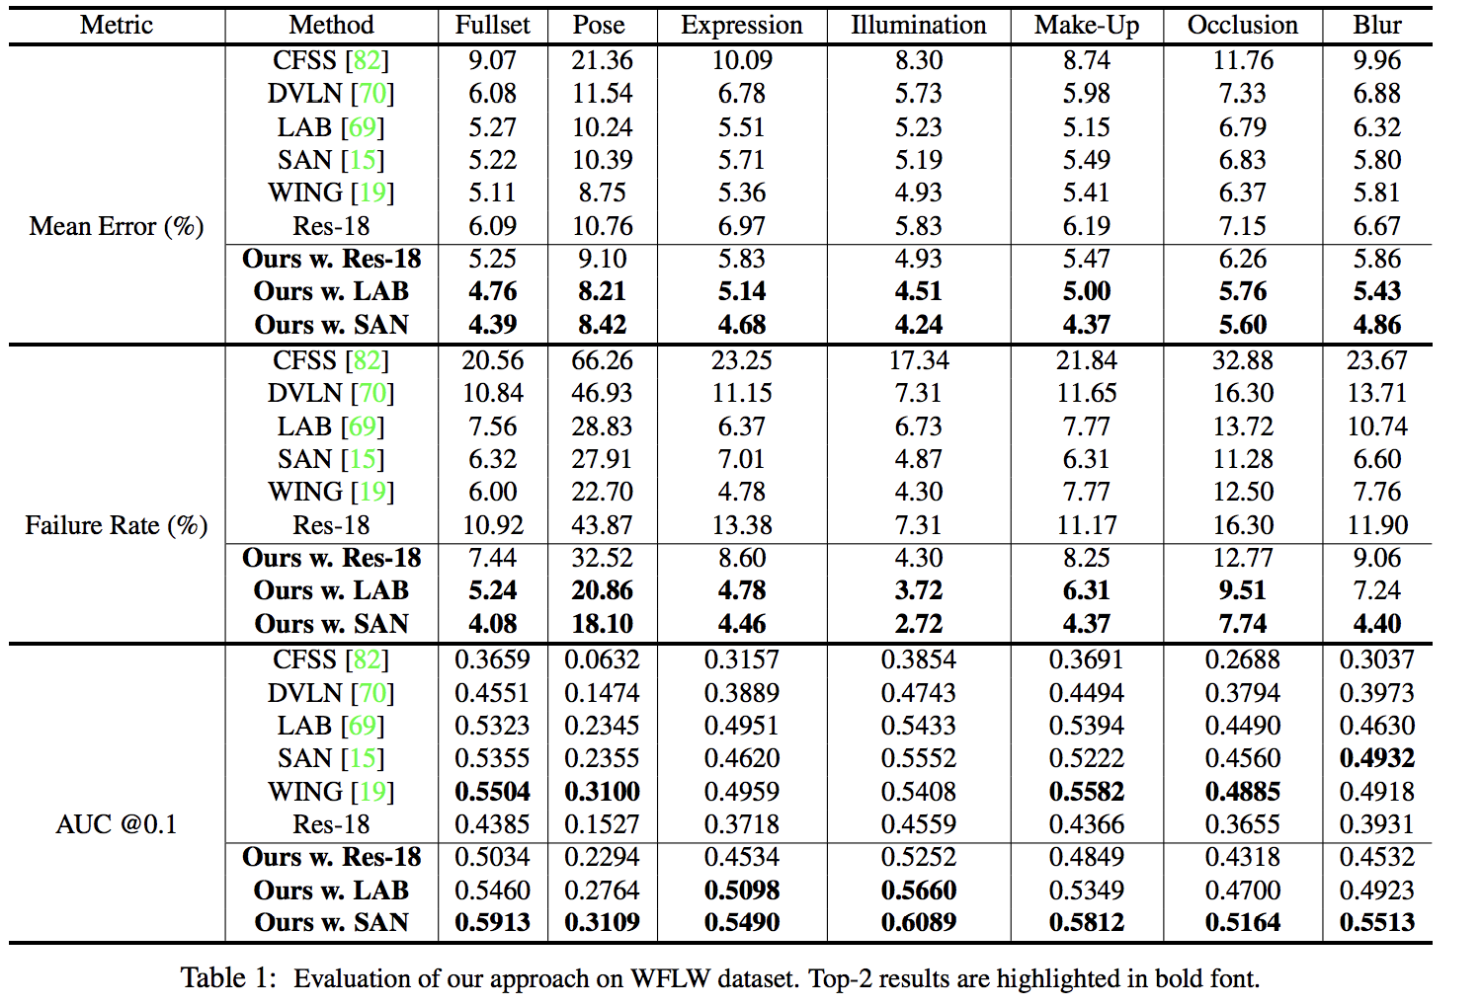
Experiment Results

Slide 20
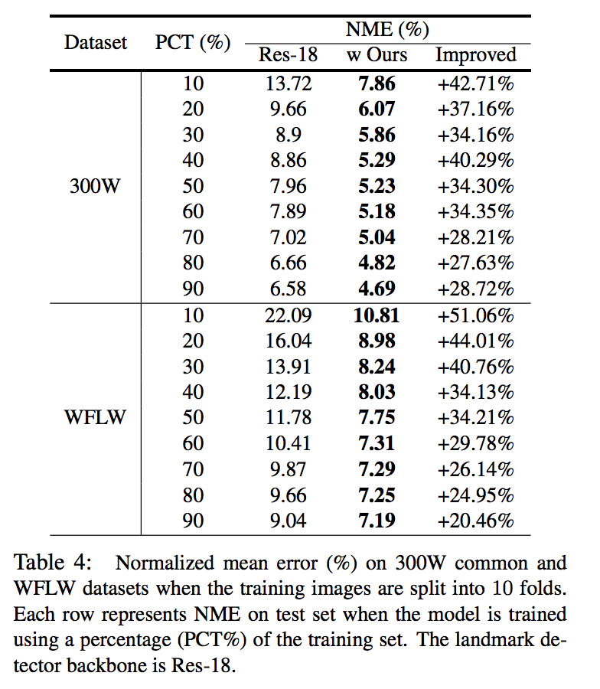
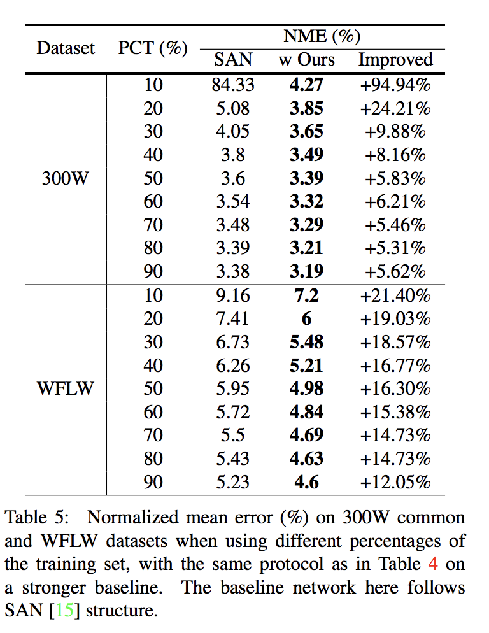
Experiment Results
Experiments on limited training data. We can see that style translation can gain more improvement when there are less training samples

Slide 21
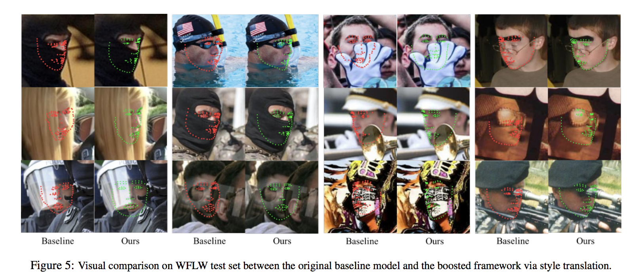
Experiment Results

Slide 22
Boosting Facial Landmark Detector with Semi-Supervised Style Translation.
Code and models in the paper are available at https://github.com/thesouthfrog/stylealign
S. Qian et al. Aggregation via Separation: Boosting Facial Landmark Detector with Semi-Supervised Style Translation.
In ICCV, 2019.

